Slide 1
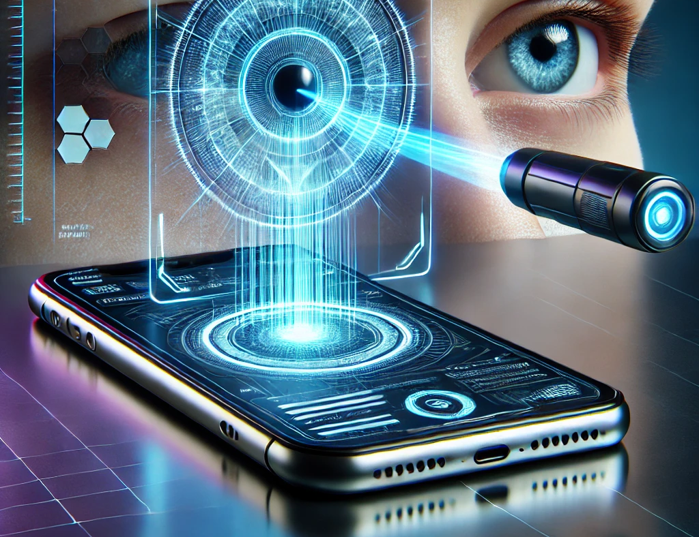
EyeNet AI-Driven Early Eye Conditions Detection using Video Analysis
Capstone Project Phase A
Project Code: 25-1-D-3
Gal Bitton
Ron Bendel
Supervisors:
Mrs.Elena Kramer
Dr.Dan Lemberg

Slide 2

Table of Contents
3
Introduction
4
Proposed Solution
5
System Workflow
6
Face & Eye Detection
7-8
DLib
9-12
Keras Models
13-14
DenseNet121
15
Attention Mechanism
16
Architecture
17
Expected Challenges
18
Evaluation Plan
19-23
GUI
Introduction
Proposed Solution
Sys’ Workflow
Face&Eye Detection
DLib
Keras Models
DenseNet121
Attention Mechanism
Architecture
Expected Challenges
Evaluation Plan
GUI

Slide 3
Introduction
High global prevalence of preventable eye conditions
Lack of accessible, user-friendly diagnostic tools
Existing solutions focus on one eye condition
Traditional diagnostic methods require a doctor’s appointment and the presence of specialized equipment.
EyeNet bridges this gap by using AI-Driven video analysis
3
Introduction
Proposed Solution
Sys’ Workflow
Face&Eye Detection
DLib
Keras Models
DenseNet121
Attention Mechanism
Architecture
Expected Challenges
Evaluation Plan
GUI

Slide 4
Proposed Solution
Video Decomposition using OpenCV
Face and Eye Detection using DLib
Eye Conditions Detection using EyeNet Model
User-Friendly Interface
4
Introduction
Proposed Solution
Sys’ Workflow
Face&Eye Detection
DLib
Keras Models
DenseNet121
Attention Mechanism
Architecture
Expected Challenges
Evaluation Plan
GUI

Slide 5
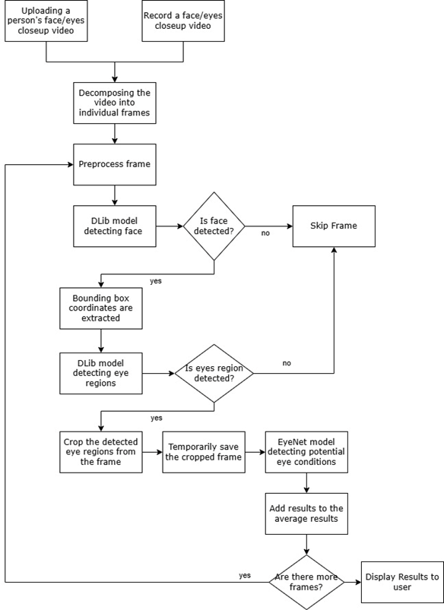
System Workflow
5
Introduction
Proposed Solution
Sys’ Workflow
Face&Eye Detection
DLib
Keras Models
DenseNet121
Attention Mechanism
Architecture
Expected Challenges
Evaluation Plan
GUI

Slide 6
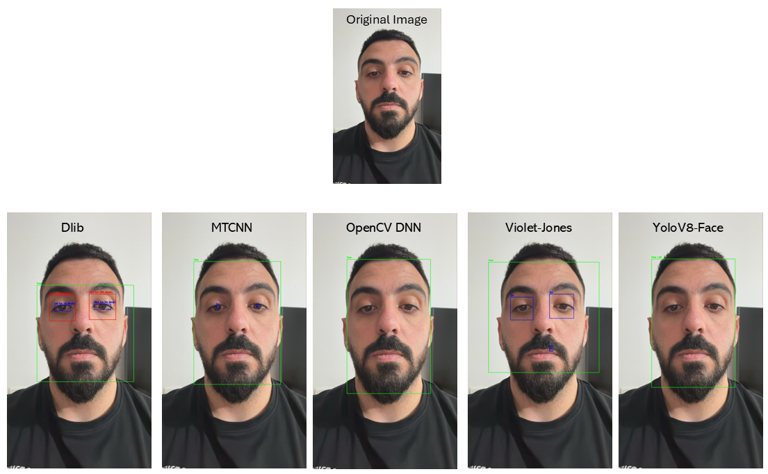
Face and Eye Detection
Algorithm | Strengths | Limitations
Viola-Jones | Fast, lightweight | Low accuracy in dynamic settings
MTCNN | High accuracy, multi-task learning | Slower processing on large inputs
YOLO | Real-time performance | Requires high GPU capabilities
OpenCV | Optimized for lightweight tasks | Limited robustness
DLib | Precise landmark detection | Computationally intensive
6
Introduction
Proposed Solution
Sys’ Workflow
Face&Eye Detection
DLib
Keras Models
DenseNet121
Attention Mechanism
Architecture
Expected Challenges
Evaluation Plan
GUI

Slide 7
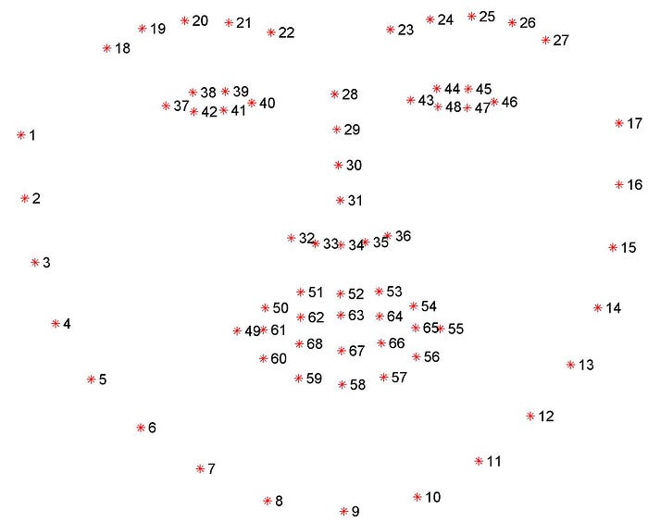

DLib
DLib is a general-purpose C++ library for machine learning and computer vision tasks.
Widely used for tasks such as:
Face Detection
Facial Landmarks prediction
Object detection
In EyeNet, we are using Dlib’s HOG (Histogram of oriented gradients) + SVM face detector and 68-point facial landmark predictor.
Points 37-48 relevant for eye’s area
7
Introduction
Proposed Solution
Sys’ Workflow
Face&Eye Detection
DLib
Keras Models
DenseNet121
Attention Mechanism
Architecture
Expected Challenges
Evaluation Plan
GUI

Slide 8

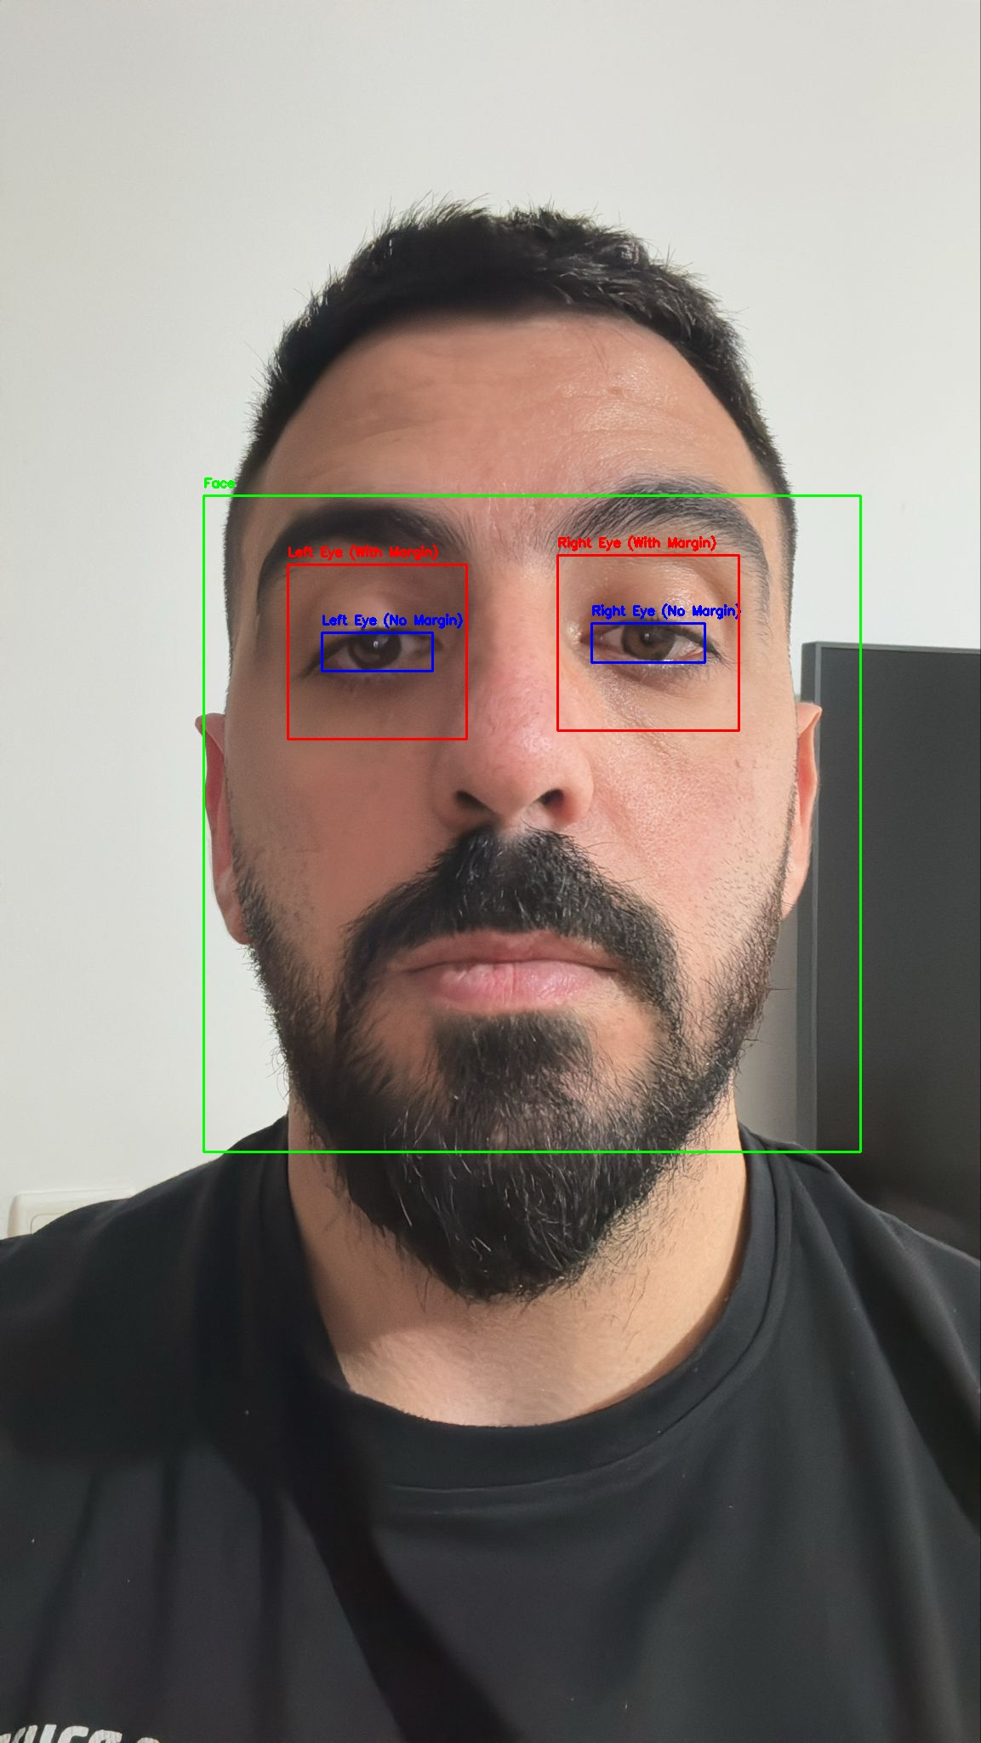
DLib’s Flow
Histogram of Oriented Gradients (HOG)
Extracts gradient orientations from localized image patches
Creates a robust feature descriptor
Linear Support Vector Machine (SVM)
Uses extracted HOG features to classify regions as “face” or “non-face”.
SVM Model
Noise Removal
HOG Feature Descriptor
Face and Eye Detection
8
Introduction
Proposed Solution
Sys’ Workflow
Face&Eye Detection
DLib
Keras Models
DenseNet121
Attention Mechanism
Architecture
Expected Challenges
Evaluation Plan
GUI

Slide 9
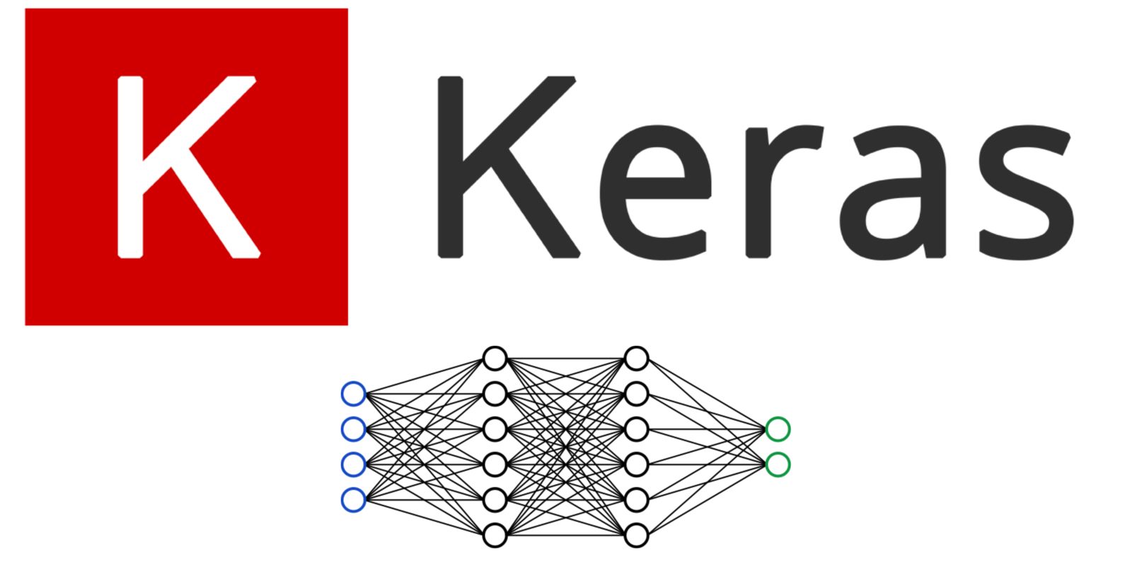
Keras Models
Deep learning models requires high-quality hardware and enough computing power to train complex models.
We run the models our personal computers (AMD Ryzen 9 7950X, 64GB RAM, Nvidia GeForce RTX 4080 Super).
The limited computational power is not enough for training deep learning models.
From Keras.io site: “Keras Applications are deep learning models that are made available alongside pre-trained weights. These models can be used for prediction, feature extraction, and fine-tuning.”
For EyeNet we used four pre-trained models: VGG16, ResNet50, Inception V3 and DenseNet-121.
9
Introduction
Proposed Solution
Sys’ Workflow
Face&Eye Detection
DLib
Keras Models
DenseNet121
Attention Mechanism
Architecture
Expected Challenges
Evaluation Plan
GUI

Slide 10
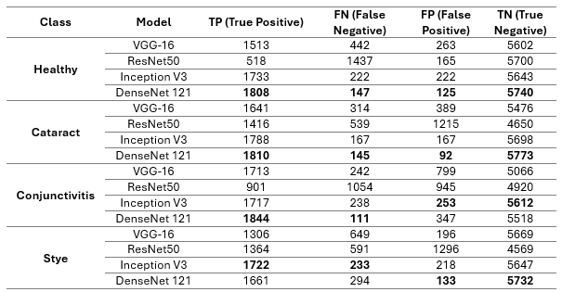
Keras Models Benchmarks
Confusion Matrix for each class, testing on 4 Keras pre-trained models
10
Introduction
Proposed Solution
Sys’ Workflow
Face&Eye Detection
DLib
Keras Models
DenseNet121
Attention Mechanism
Architecture
Expected Challenges
Evaluation Plan
GUI

Slide 11
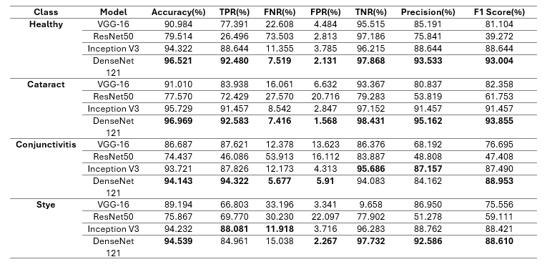
Keras Models Benchmarks
Performance evaluation matrices for all 4 Keras pre-trained models
11
Introduction
Proposed Solution
Sys’ Workflow
Face&Eye Detection
DLib
Keras Models
DenseNet121
Attention Mechanism
Architecture
Expected Challenges
Evaluation Plan
GUI

Slide 12
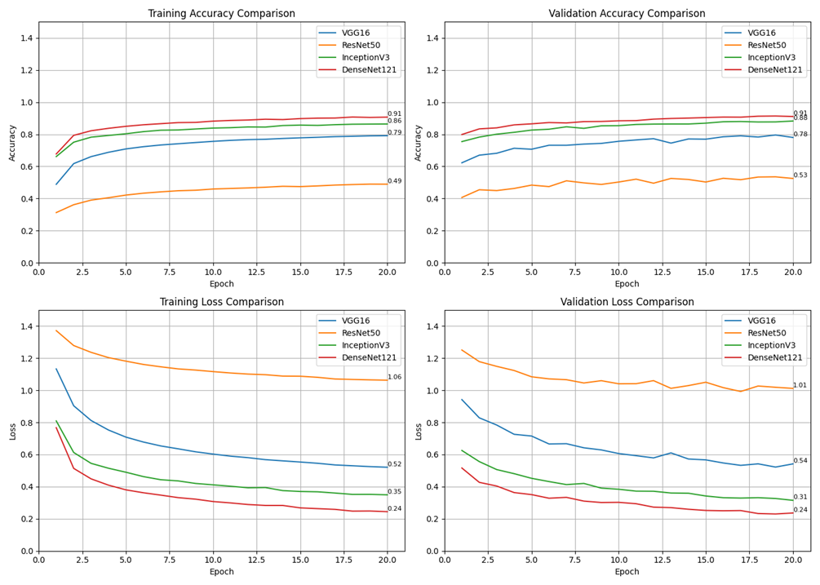
Keras Models Benchmarks
Visualization of the pre-trained models training and validation process
12
Introduction
Proposed Solution
Sys’ Workflow
Face&Eye Detection
DLib
Keras Models
DenseNet121
Attention Mechanism
Architecture
Expected Challenges
Evaluation Plan
GUI

Slide 13
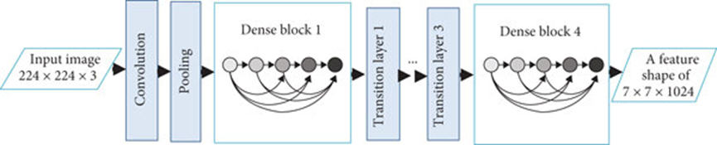
DenseNet121
Dense Block 2
Dense Block 3
56x56
1x1 conv x6
3x3 conv x6
28x28
1x1 conv x12
3x3 conv x12
14x14
1x1 conv x24
3x3 conv x24
7x7
1x1 conv x16
3x3 conv x16
DenseNet121 is a deep neural network with 121 layers, leveraging dense connectivity to improve efficiency and performance.
Dense Connectivity: Each layer connects to all preceding layers, enhancing feature reuse and mitigating the vanishing gradient issue.
Compact Architecture: Approximately 8 million parameters, making it computationally efficient.
Excels in tasks like image classification and object detection.
112x112
7x7 conv, stride 2
Transition layer 2
56x56
1x1 conv
28x28
14x14
1x1
13
Introduction
Proposed Solution
Sys’ Workflow
Face&Eye Detection
DLib
Keras Models
DenseNet121
Attention Mechanism
Architecture
Expected Challenges
Evaluation Plan
GUI

Slide 14

DenseNet121-What is Dense Block?
What is a Dense Block?
A series of layers where each layer receives inputs from all previous layers and passes its output to all subsequent layers.
Operations: Batch Normalization, ReLU, 1×1 Convolution, and 3×3 Convolution.
Purpose:
Maximizes feature reuse, reducing redundancy.
Facilitates better learning and efficient computation.
Outcome:
Extracts rich, hierarchical features.
Improves learning dynamics for deeper architectures.
14
Introduction
Proposed Solution
Sys’ Workflow
Face&Eye Detection
DLib
Keras Models
DenseNet121
Attention Mechanism
Architecture
Expected Challenges
Evaluation Plan
GUI

Slide 15
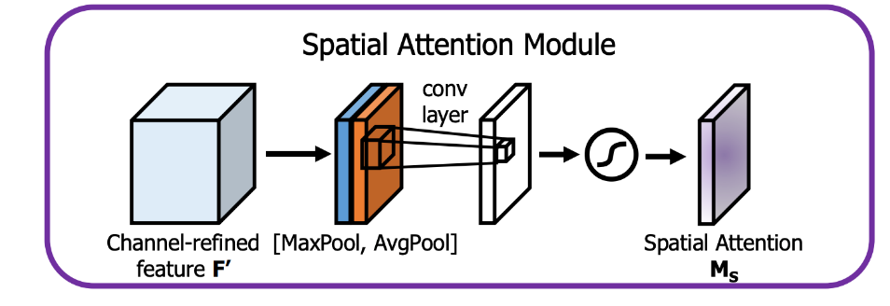
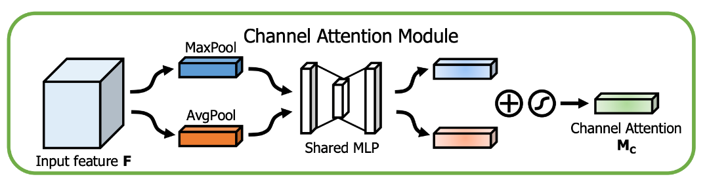


Attention Mechanism
Channel attention focuses on “what” is important (channels), while spatial attention focuses on “where” it is important (spatial regions).
Spatial Attention Mechanism
Focus on important spatial regions in the feature map.
Combines MaxPool and AvgPool across channels to form a 2D descriptor.
Passes the combined output through a convolutional layer.
Applies a sigmoid function to generate spatial attention ($M_{S}$)
Enhances spatially relevant areas in the input features.
Channel Attention Mechanism
Focus on important feature channels.
Applies MaxPool and AvgPool to the input feature map independently.
Pooled features pass through a shared MLP (Multi-Layer Perceptron).
Combines outputs via element-wise addition and passes through a sigmoid function to generate channel attention ($M_{C}$​ )
Highlights significant channels while suppressing less important ones
15
Introduction
Proposed Solution
Sys’ Workflow
Face&Eye Detection
DLib
Keras Models
DenseNet121
Attention Mechanism
Architecture
Expected Challenges
Evaluation Plan
GUI

Slide 16
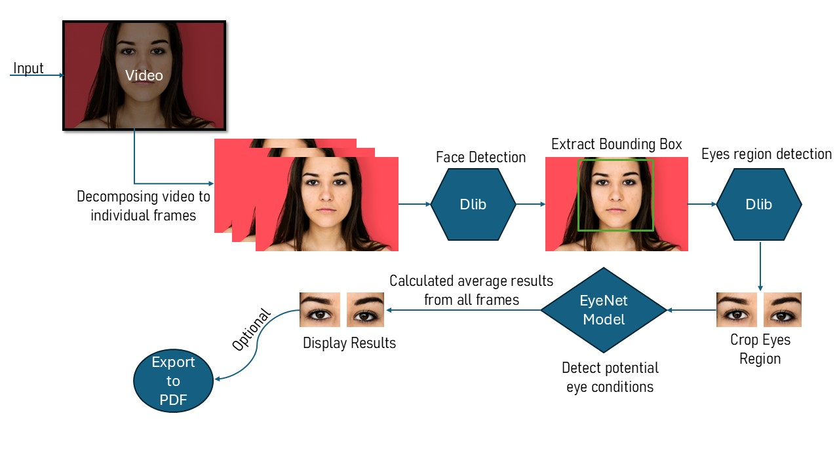
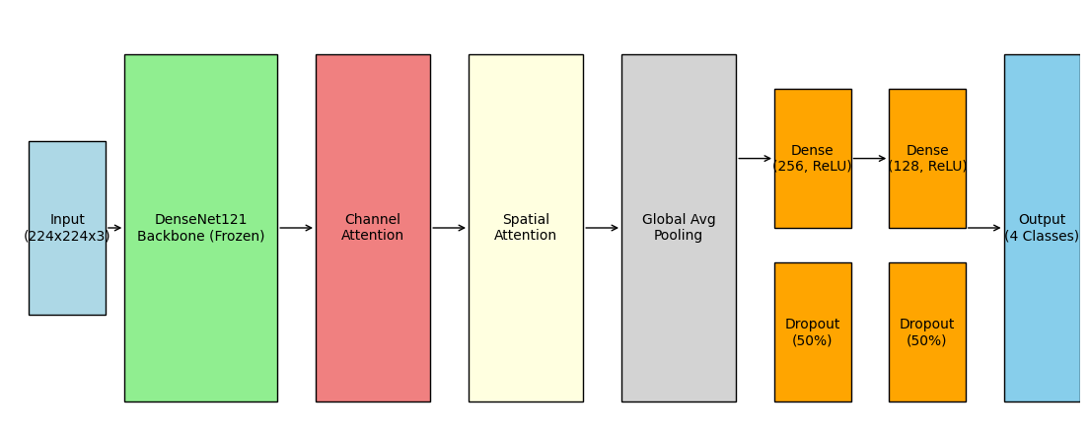
Architecture
EyeNet Model Architecture
EyeNet Application Architecture
16
Introduction
Proposed Solution
Sys’ Workflow
Face&Eye Detection
DLib
Keras Models
DenseNet121
Attention Mechanism
Architecture
Expected Challenges
Evaluation Plan
GUI

Slide 17
1
Proper diagnosis and treatment of image disturbances (blur, lighting conditions)
Expected Challenges
2
Building a reliable application with a user-friendly interface
3
Achieving high accuracy across diverse data inputs.
4
Compatibility with different devices and different image qualities
17
Introduction
Proposed Solution
Sys’ Workflow
Face&Eye Detection
DLib
Keras Models
DenseNet121
Attention Mechanism
Architecture
Expected Challenges
Evaluation Plan
GUI

Slide 18
Evaluation Plan
Goals
Eye condition detection with high accuracy
Efficient video processing
User-friendly interface
Performance
Classification accuracy>90
Video’s process time <=15 seconds
Robustness
Handle poor image conditions
Provide clear error messages
User Satisfaction
Collect feedback from users
Testing Approach
Test with real-world datasets
Test EyeNet with eye’s doctor and real patients
18
Introduction
Proposed Solution
Sys’ Workflow
Face&Eye Detection
DLib
Keras Models
DenseNet121
Attention Mechanism
Architecture
Expected Challenges
Evaluation Plan
GUI

Slide 19
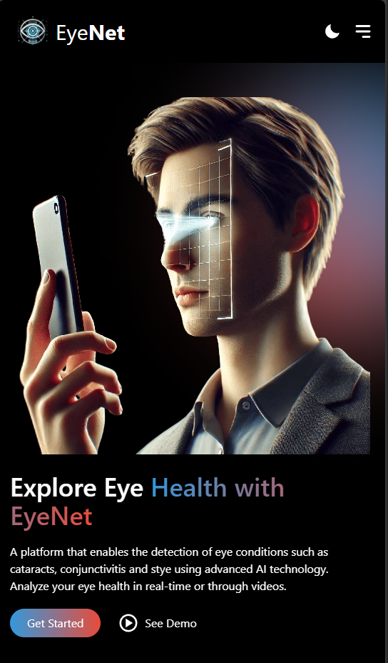
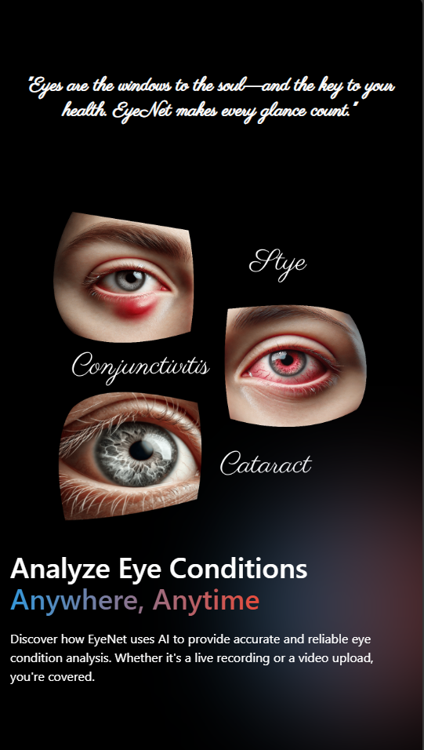
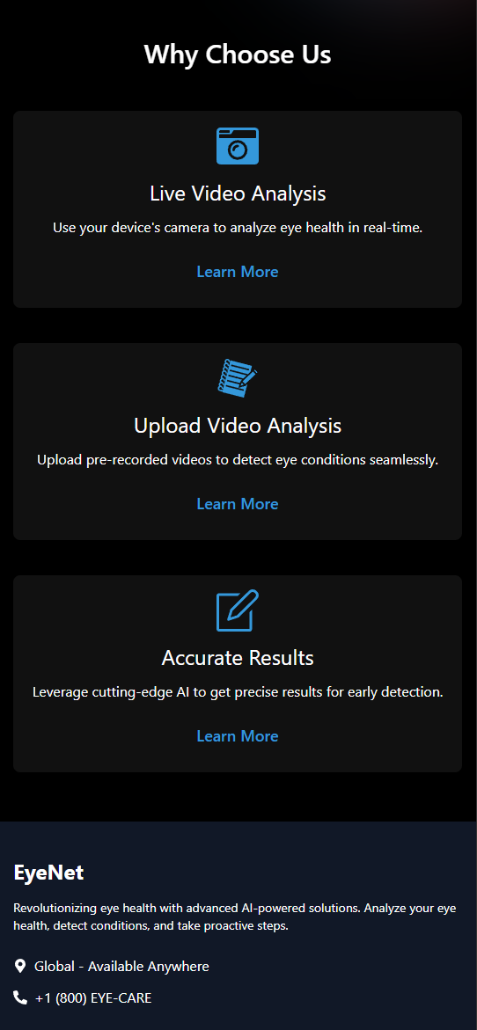
19
Introduction
Proposed Solution
Sys’ Workflow
Face&Eye Detection
DLib
Keras Models
DenseNet121
Attention Mechanism
Architecture
Expected Challenges
Evaluation Plan
GUI

Slide 20

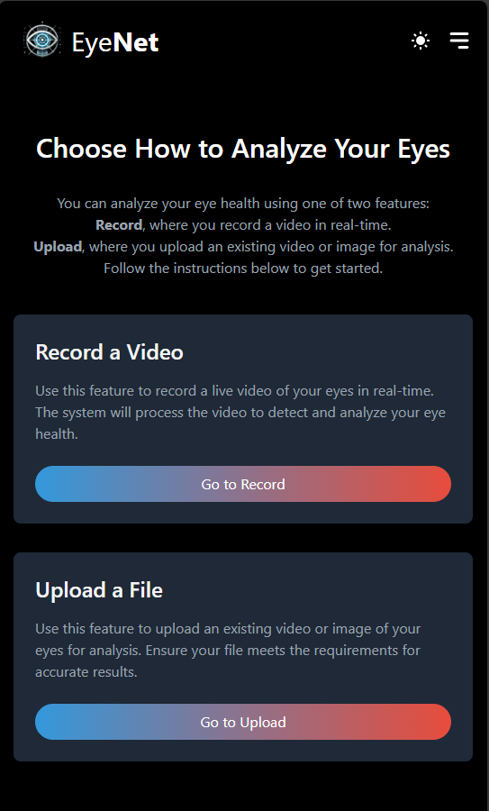
After clicking on Get Started
20
Introduction
Proposed Solution
Sys’ Workflow
Face&Eye Detection
DLib
Keras Models
DenseNet121
Attention Mechanism
Architecture
Expected Challenges
Evaluation Plan
GUI

Slide 21
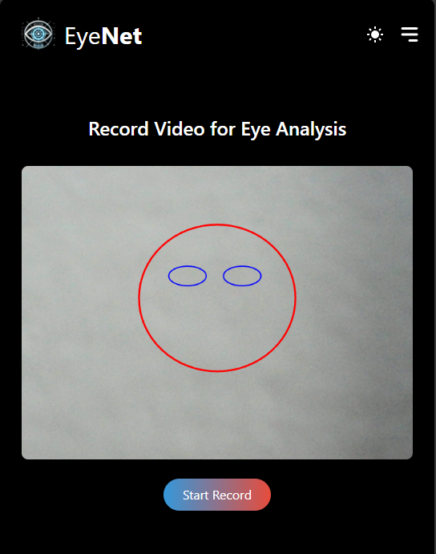

21
Introduction
Proposed Solution
Sys’ Workflow
Face&Eye Detection
DLib
Keras Models
DenseNet121
Attention Mechanism
Architecture
Expected Challenges
Evaluation Plan
GUI

Slide 22
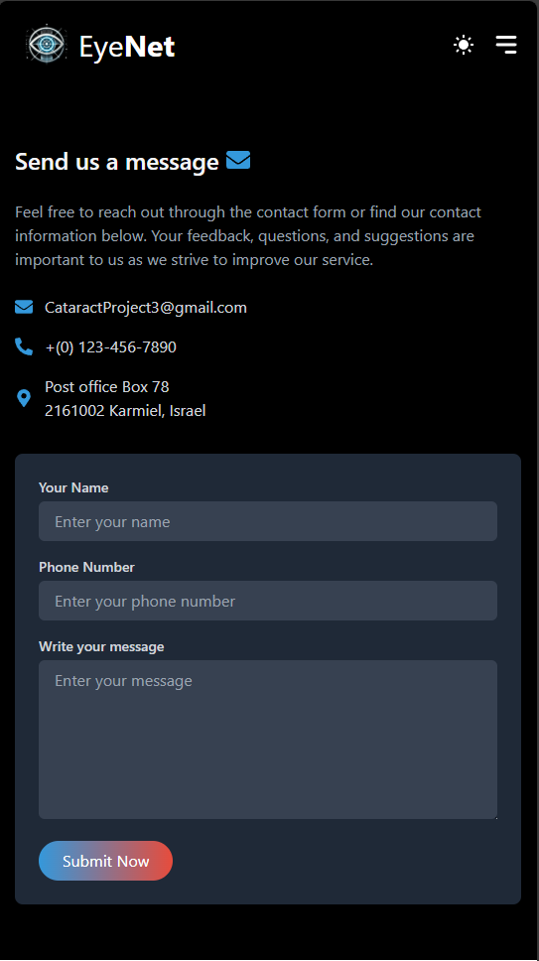
22
Introduction
Proposed Solution
Sys’ Workflow
Face&Eye Detection
DLib
Keras Models
DenseNet121
Attention Mechanism
Architecture
Expected Challenges
Evaluation Plan
GUI

Slide 23
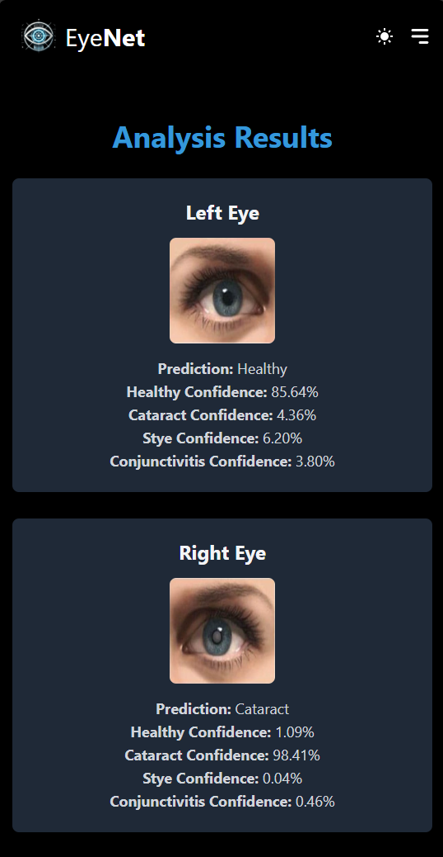
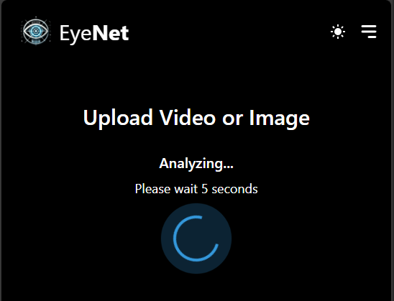
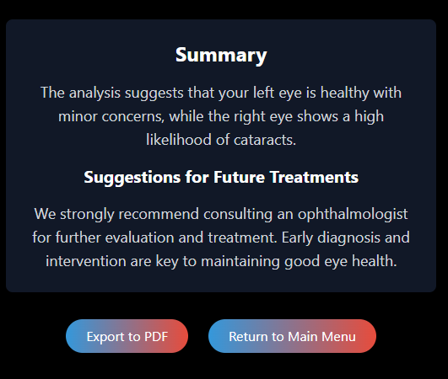
After recording/uploading a video
23
Introduction
Proposed Solution
Sys’ Workflow
Face&Eye Detection
DLib
Keras Models
DenseNet121
Attention Mechanism
Architecture
Expected Challenges
Evaluation Plan
GUI

Slide 24

Thank you for Listening!
24

